Slide 1
Skin Disease Diagnosis on Darker Skin
By: Reagan Esteves, Jamie Hartman, Charles Tyndal, and Chenyu Zhao
Faculty Mentors: Dr. Zhengming Ding and Dr. Jihun Hamm

Slide 2
Requirements
"Elevator pitch": the brief summary of your problem and results. Think of it as a summary you'll be giving 20 times at the Capstone Expo when people come up to your poster
Demonstration of your product/features implemented in Milestone 6. The product should be in a release state.
For team projects, the contributions of all team members need to be clearly outlined. Unless you were previously explicitly authorized not to maintain your project on Github, the project should be on Gitfhub. Frequent (at least every other day) contributions from all team members should be visible. There should be one main branch with the latest state of the project (tagged "Milestone 6 release") and no more than two development feature branches.

Slide 3


Slide 4
Overview
Use AI to identify skin diseases in people with darker skin tones
Why?
To address racial disparities in current AI recognition -> leads to misdiagnosis
patients unable to afford (expensive)
Image source dataset: sub-Saharan African hospitals
Focus: Buruli Ulcer, Yaw, Mycetoma, Leprosy, Scabies
Our Tasks:
Enhancing images (cropping, filtering, applying boundary boxes and masks)
Mask_RCNN & Superpixel
Our Goals:
Improve accuracy and diagnosis wait times

Slide 5
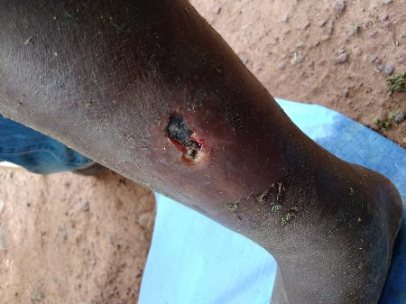
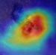
ROI Detection
[Weakly supervised Segmentation]
Aim 1: Automatic Preprocessing
Input: Raw Images
Enhancement
[Super-resolution, Color calibration]
Output 1
middle calf
[Deep learning,
Visual patterns]
[Domain adaptation, Augmentation]
Output 3
Aim 3:
Interpretation
Aim 2:
Disease Diagnosis
Output 2
Disease: buruli ulcer
Confidence: 90%
Visual Cues
Recovery Status

Slide 6
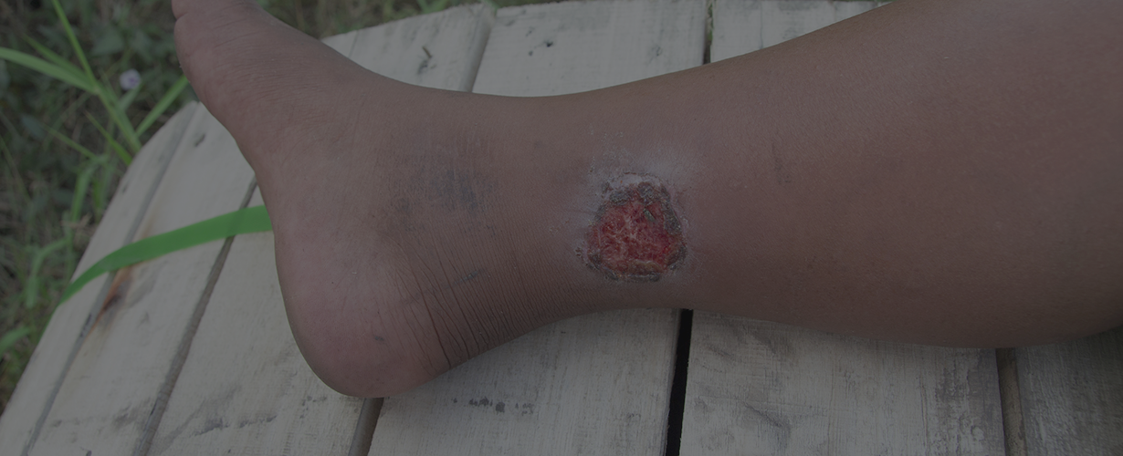
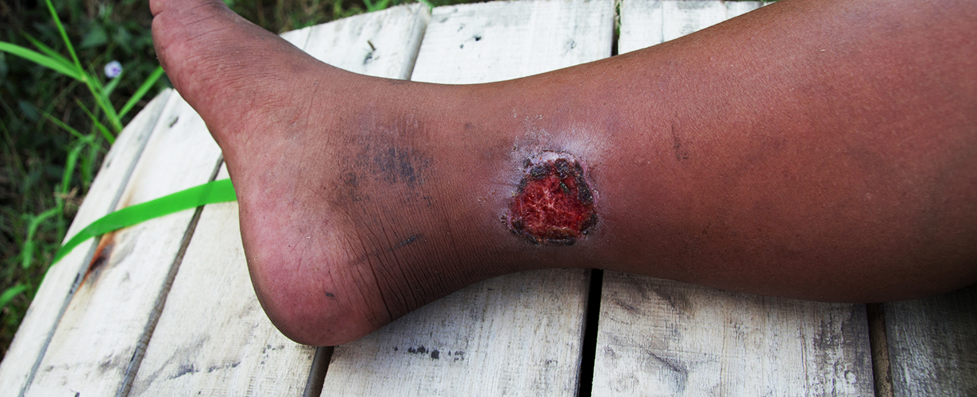
Application
Mr. A has a Buruli ulcer
Can’t meet expense and time for appointment and treatment
Solution: take a photo of the problem -> upload into our Application (Picture A)
Application crops to bodypart/area of disease
Image is enhanced (Picture B)
Diagnosis is provided: Buruli Ulcer, and the confidence level
Picture A
Picture B

Slide 7
01
Last Semester’s Results

Slide 8
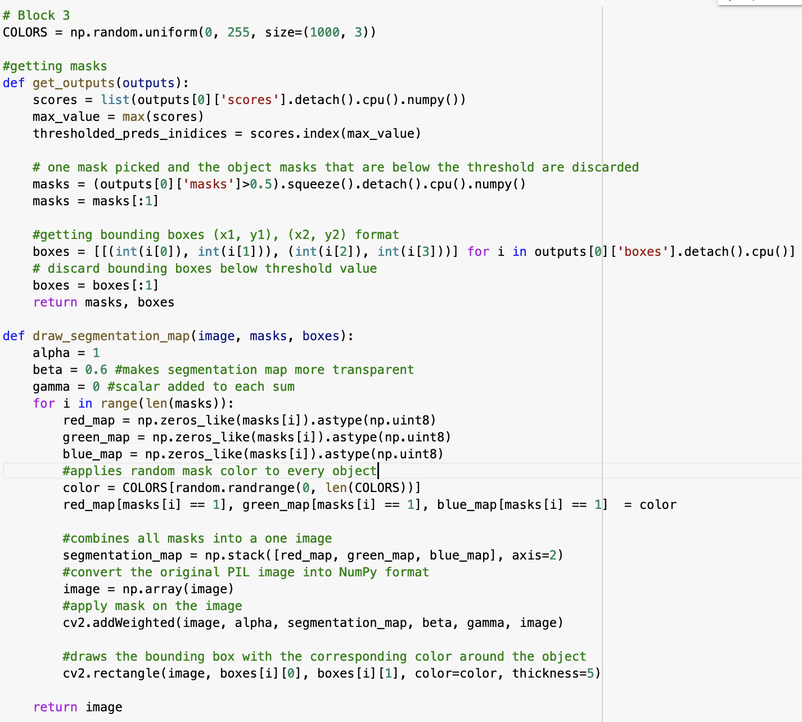
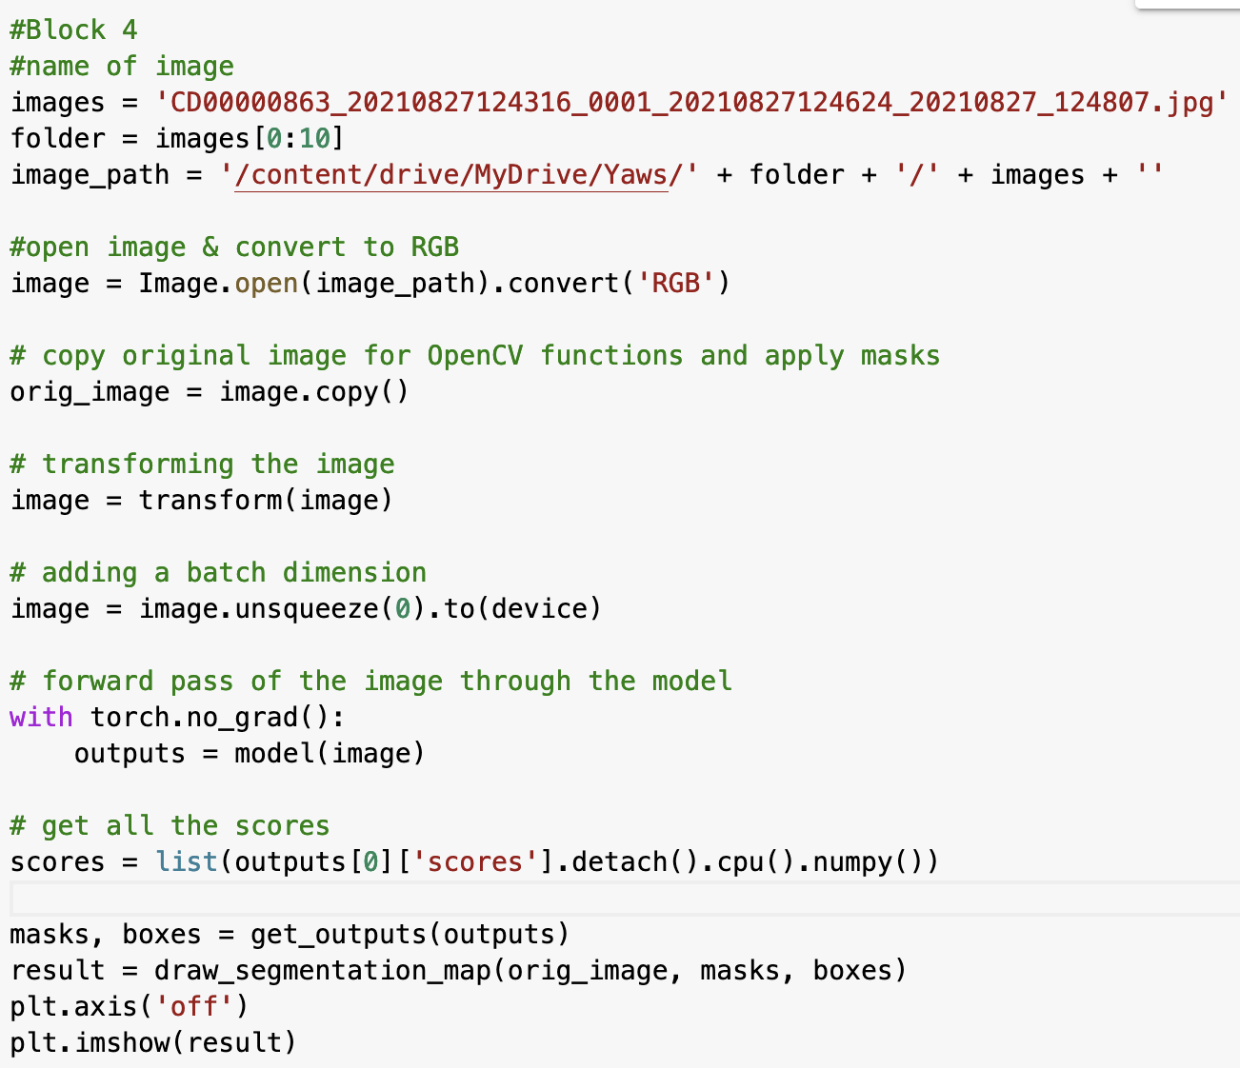
Mask RCNN
Instance segmentation, detects objects’ masks, and return object bounding boxes
Purpose:
Getting the bounding boxes and drawing the segmentation
Runs segmentation & bounding boxes through the images
‹#›

Slide 9
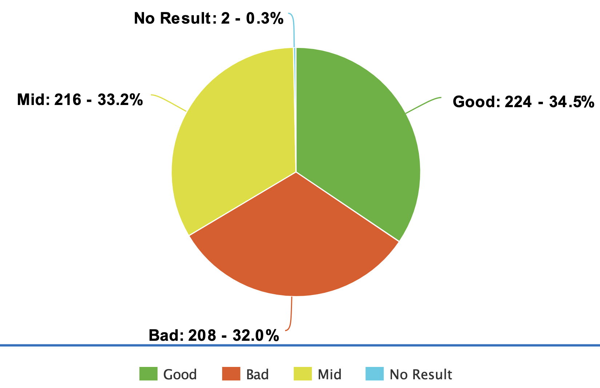
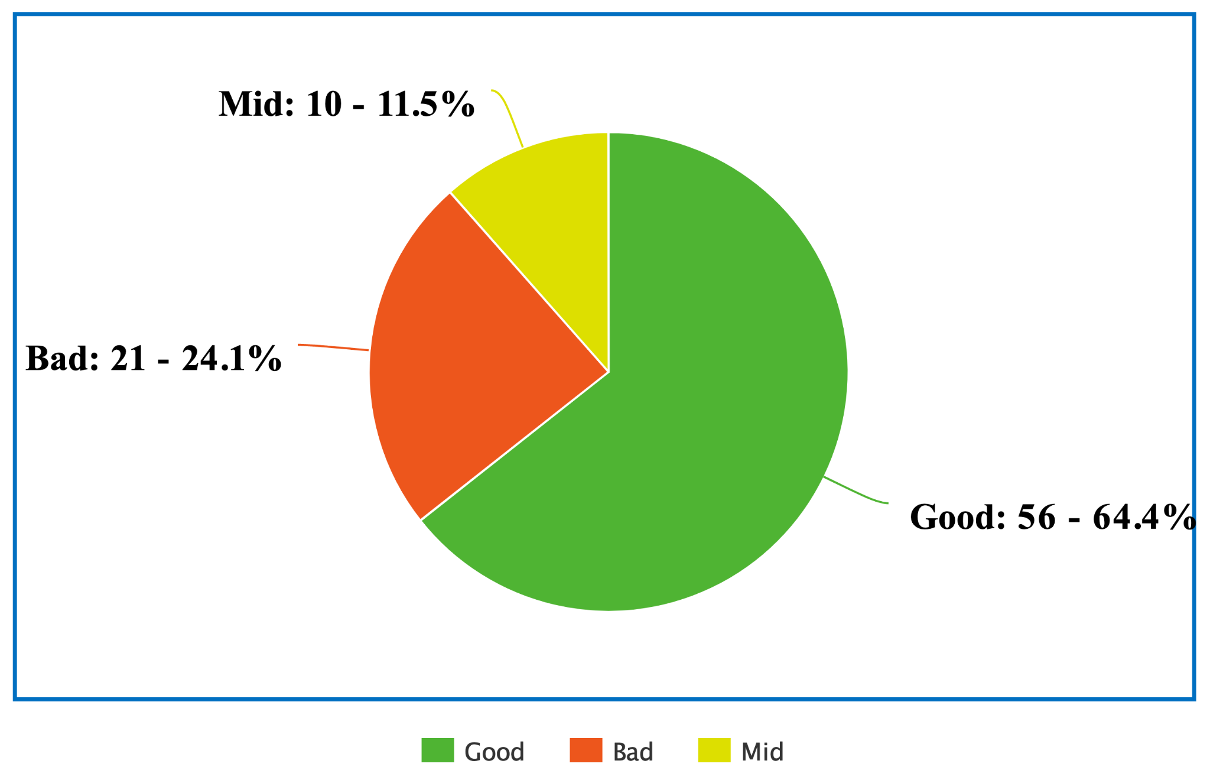
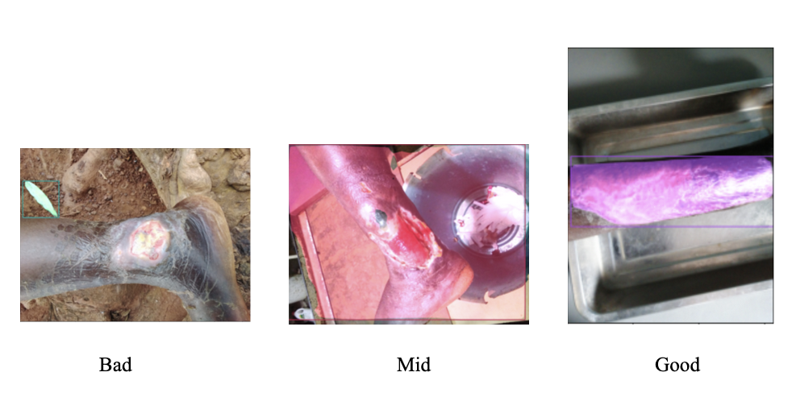
Mask RCNN Results
Ratings
Good = bounding box on body part
Mid = bounding box on body part and background
Bad= bounding box not on body part
Accuracy: Mid
Problems: Non uniform backgrounds, overexposure
Buruli Ulcer

Slide 10
02
Work Conducted So Far

Slide 11
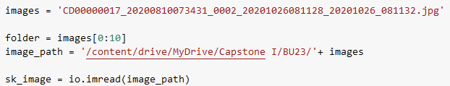
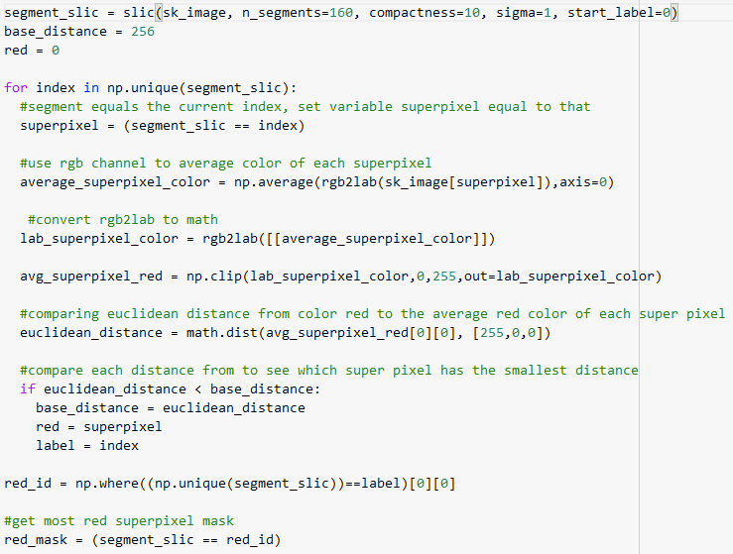
Superpixel
Clustering pixels based on shared similar visual characteristics (color)
Purpose :
To simplify and reduce the complexity of image (segmentation)
Easier skin disease recognition using the color channel
Example: Buruli Ulcer (red wound)
Use RGB channel in superpixel to find clusters of red pixels
Detect most red cluster based on euclidean and base distance
Obtain most red superpixel mask

Slide 12
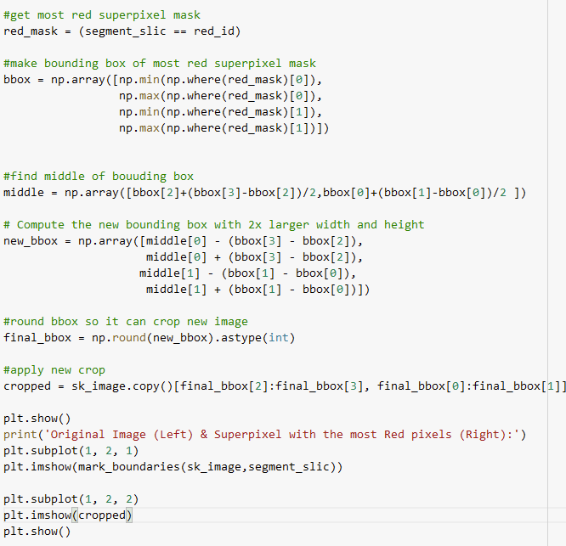
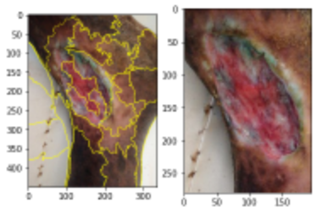
Superpixel Cropping
Purpose: crop image to skin disease area
Example: Buruli Ulcer cont’d
make bounding box on most red superpixel mask
make bounding box larger
crop to the bounding box size

Slide 13
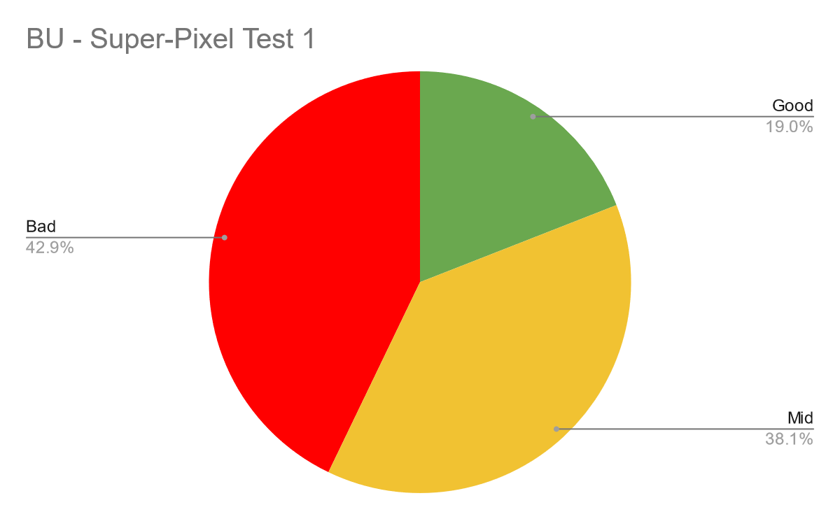
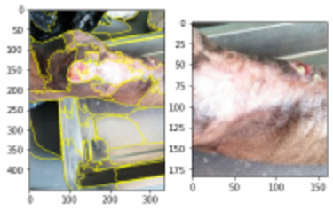
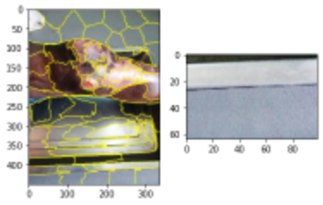
Superpixel + Crop Results (RGB)
Done on low resolution pictures of Buruli Ulcer
Good = Crop on skin disease area
Mid = Partial Crop on skin disease area
Bad = No crop on skin disease area
Accuracy : Poor
Problems: High composition of red pixels in brown and white
Good
Mid
Bad

Slide 14
03
?

Slide 15
04
Timeline

Slide 16
Monday | Tuesday | Wednesday | Thursday | Friday | Saturday | Sunday
30 | 31 | 01 | 02 | 03 | 04 | 05
06 | 07 | 08 | 09 | 10 | 11 | 12
13 | 14 | 15 | 16 | 17 | 18 | 19
20 | 21 | 22 | 23 | 24 | 25 | 26
27 | 28 | 29 | 30 | 31 | 01 | 02
03 | 04 | 05 | 06 | 07 | 08 | 09
Timeline
Meetings
this is how you're going to spend time with your new family
Phasellus commodo risus semper lacinia feugiat aliquam semper tempor erat quis. Quisque condimentum purus lectus, vitae ultricies ante interdum non. Nunc ut quam eu lacus dignissim ultricies eu sit amet augue.
Design
Develop
Fixes

